Slide 1
Preparing FAIR Learning Objects
WP2 T3

Slide 2
Learning Objectives
Recognize metadata
Identify Permanent Identifiers (PIDs)
Compare licenses
Write attribution
Categorize learning repositories
Interpret the instructional design process
Prepare learning objectives

Slide 3
Agenda
Storing FAIR data
IPR
Learning Objectives

Slide 4

Metadata
metadata = structured information that describes, explains and locates a resource
WHO created the resource
WHAT is the content of the resource
WHEN was the data resource
WHERE is the location of the resource
WHY the data was resource
Metadata Digital Preservation by Jørgen Stamp. The illustration is copyright of digitalbevaring.dk and shared under a CC BY 2.5 Denmark license

Slide 5

The RDA Minimal Metadata for Learning Resources
Controlled vocabularies
Image: Minimum set of metadata for learning resources
Taken from Hoebelheinrich, Nancy J, Biernacka, Katarzyna, Brazas, Michelle, Castro, Leyla Jael, Fiore, Nicola, Hellström, Margareta, Lazzeri, Emma, Leenarts, Ellen, Martinez Lavanchy, Paula Maria, Newbold, Elizabeth, Nurnberger, Amy, Plomp, Esther, Vaira, Lucia, van Gelder, Celia W G, & Whyte, Angus. (2022). Recommendations for a minimal metadata set to aid harmonised discovery of learning resources on Zenodo licensed under CC BY 4.0

Slide 6
Learning materials repositories
Instructors
Zenodo (from GitHub)
Learners
Skills4EOSC Learning Platform (LMS)

Slide 7
PIDs
Type of metadata that uniquely tags a digital object
Leads to landing page with the listed digital object and its metadata
Actual access to the digital object from this page may be restricted
Helps distinguish between
different materials
different versions of the same material
Instructors
DOI
Learners
LMS ID

Slide 8
IPR
Protects the interests of the creators and owners by providing them with rights over their creation
Original work can be protected by copyright law granting the owner exclusive rights to control certain rights such as reproduction
copyright is owned jointly by all authors
or it may be owned by the employing institution
Use of copyright-protected work requires permission from the owner
The owner can use a license to transfer this right to other people.
Intellectual Property by Nick Youngson CC BY-SA 3.0 Alpha Stock Images

Slide 9


Creative Commons Licenses
Taken from Creative Commons license Wikipage (2023, June 21) in Wikipedia licensed under the Creative Commons Attribution-ShareAlike License 4.0 / cropped

Slide 10

Apply a license
indicate which CC license you are applying to your work
check the terms of the chosen license and comply with the requirements therein
e.g. strongly recommended to include a link to the relevant CC license deed such as
https://creativecommons.org/licenses/by/4.0
Except where otherwise noted, content on this site is licensed under a Commons Attribution 4.0 International License

Slide 11
Choose and apply a license
Try using the CC License Chooser tool
How are you going to apply the chosen license to your work?
How restrictive are ND and SA when it comes to reuse?

Slide 12
Attribution
Moral right - always needed
Ideal attribution = TASL
Title - what is the name of the work
Author - who allows you to use the work (name and link)
Source - where can the work be found (link added to title)
License - how can the work be used (name and link to the license)
CC Recommended practices for attribution
Title
Author
Source
License

Slide 13
Attribution examples
Image attribution
"Creative Commons 10th Birthday Celebration San Francisco" by Timothy Vollmer is licensed under CC BY 4.0
Adapted image attribution
"Creative Commons 10th Birthday Celebration San Francisco" by Timothy Vollmer is licensed under CC BY 4.0 / Cropped from original
Text attribution
This chapter is from “You Don't Know JS Yet (2nd Edition)” by Kyle Simpson. The book is licensed under the CC BY-NC-ND 4.0 license. © 2019-2022 Kyle Simpson.
Other
Image by AUTHOR(link) from Pixabay(link)

Slide 14
Citing
Allows authors to provide the source of any quotations, ideas, and information that they include in their own work based on the copyrighted works of other authors
The amount of information quoted must be very limited
“Fair Use” of copyright law
Sole purpose: illustration for teaching or scientific research with attribution
Varies across countries

Slide 15
Lets attribute
Write attribution for the following learning resources that you have decided to incorporate in your learning materials:
image from https://creativecommons.org/2021/12/02/unesco-recommendation-on-open-science-ratified/
TRIPLE TRAINING on Open Research Europe slides from https://project.gotriple.eu/triple-open-science-training-series/
slide 3 from Why open science? presentation by Sarah Jones https://slideplayer.com/slide/12073970/
Lesson 1: The What from https://github.com/opensciency/sprint-content/blob/main/ethos-of-open/lesson1-intro-to-open-science.md
Are you able to find all TASL elements for each example?
What are the pitfalls of not using attribution?

Slide 16
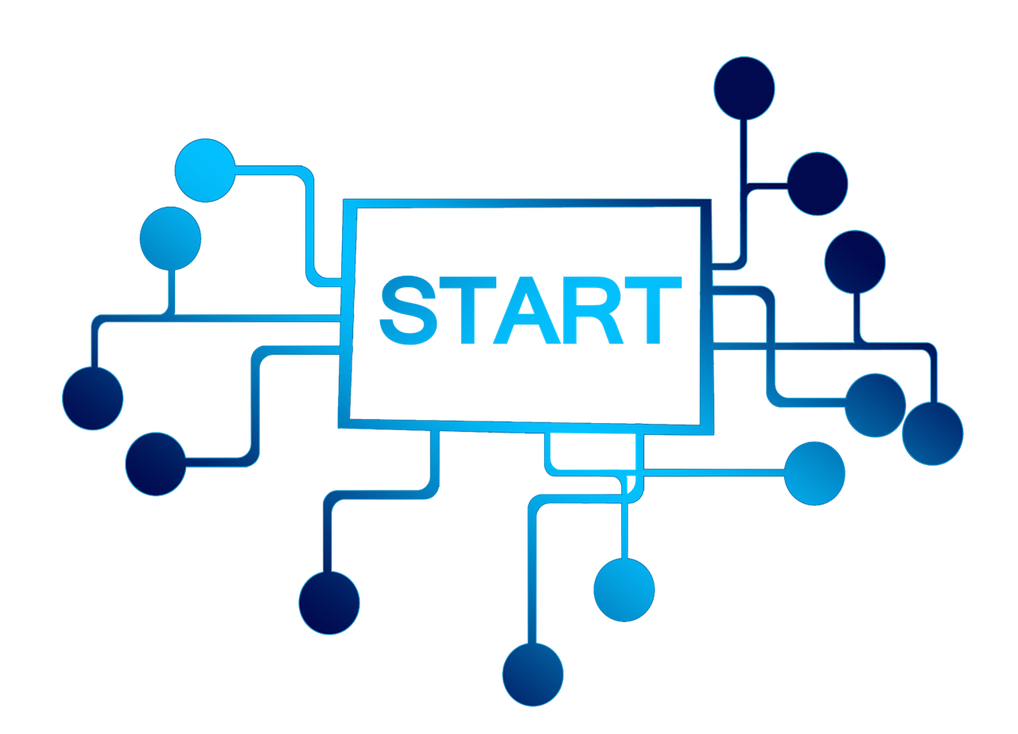
Instructional Design
Image by Gerd Altmann from Pixabay

Slide 17
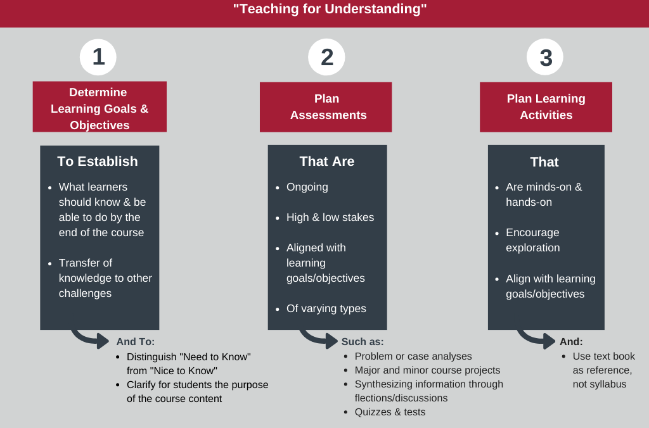
Backward Instructional Design
"Backward design model" from Muhlenberg College licensed under the CC BY-NC 4.0.

Slide 18
Step 1
Purpose of learning material
when and how the learning materials can be used and for what purposes
Target Audience
the primary audience for the learning materials
is there anything specific that needs to be taken into account, such as cultural context
Prerequisites
what does the target audience need to know or understand before starting the learning process
use names and links to other learning materials if possible
Overall Scope of the learning materials
is it going to be a single learning object or an aggregation of some sort such as a course
Learning Objectives
what competencies will be gained after successfully completing the learning process
clear definition of the overarching aspects and considerations related to the learning materials that are going to be created

Slide 19
Learning Objectives
Learning objectives refer to observable and measurable (SMART)
Knowledge
Skills
Attitudes
Focus on results of the learning experiences
reflect the desired end of the learning experience, not the means or the process
answer the question, "Why should a learner take this unit anyway?”
Anatomy of Learning Objectives
an action word that identifies the performance to be demonstrated
a learning statement that specifies what learning will be demonstrated in the performance

Slide 20
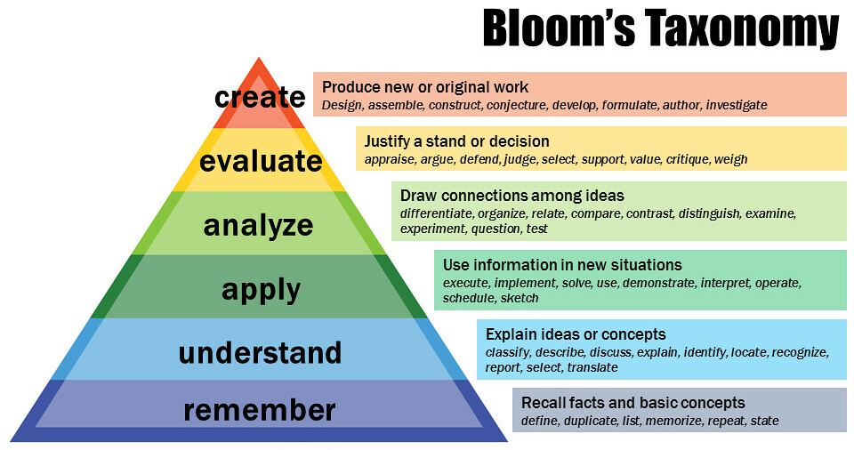
Learning Objectives – the Knowledge domain
"Bloom's Revised Taxonomy" by Vanderbilt University Center for Teaching licensed under the terms of the CC-BY-2.0.

Slide 21

Learning Objectives Verbs
Bloom's taxonomy by Fractus Learning. (2023, July 10). In Wikipedia licensed under the terms of CC BY-SA 4.0.

Slide 22
Ideation
You are in stage 1 of creating an Open Science training course for policy makers
Define the essential elements of your training course:
purpose
target audience
prerequisites
scope
min 3 learning objectives
Which of these elements are going to be part of the metadata describing your newly created learning materials?

Slide 23
Summary
FAIR learning object
Offered to learners and instructors
Described with metadata using the RDA schema
Uniquely tagged
Stored in a repo
CC Licensed
Learner-centric learning materials
Step 1: Focus on the goal and learning objectives

Slide 24
Thank you! Any questions before we continue?
sonja.filiposka@finki.ukim.mk
Cite instructions on: https://doi.org/10.5281/zenodo.12604767

